Slide 1
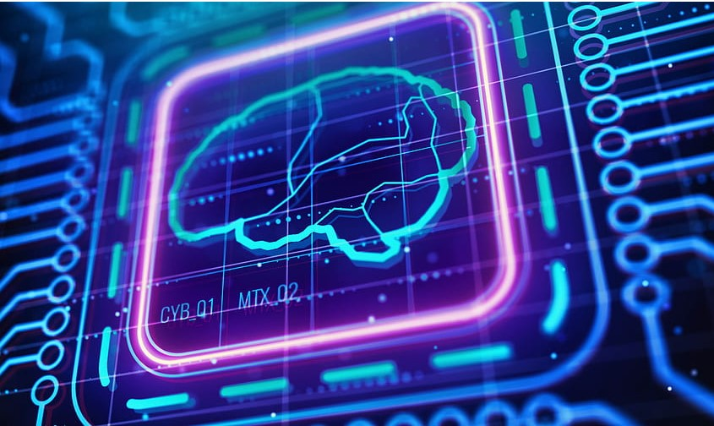
The BRAIN Chips!
Devika Ravi

Slide 2
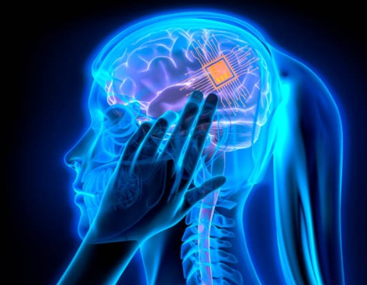
Introduction
Brain chip, also known as a Neural chip or Neuro chip, is a technology designed to interface directly with the human brain.
Elon Musk’s company Neuralink is one of the companies that is working on developing brain chips.

Slide 3
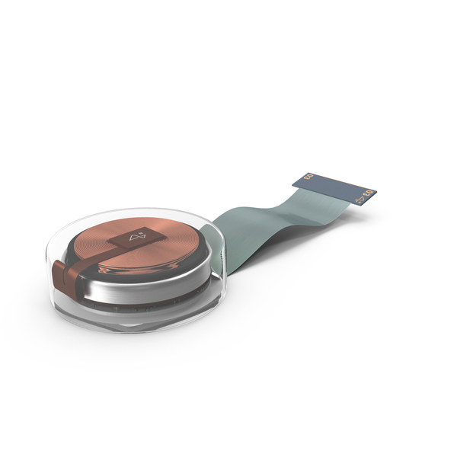
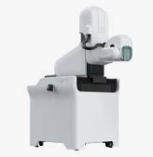
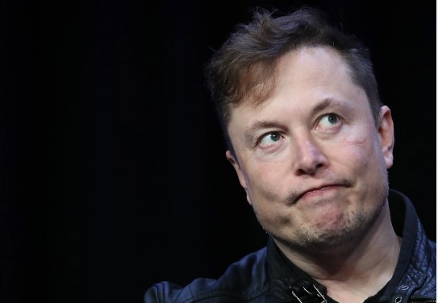

1. Neuralink Corporation? 2. Neuralink (N1) ? 3. Robot the "R1" ?
Neuralink

Slide 4

Did you know?
Did you know that having a brain chip could allow someone who doesn't even have eyes to see for the first time ever?
So, this is what you need to know about brain chips:
-The Good -The Bad - And the Ugly

Slide 5

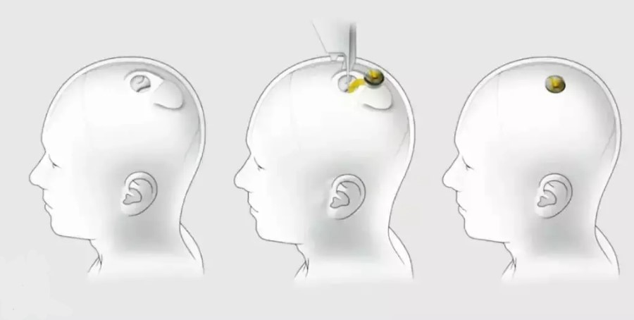
How?
How a brain chip works?
OR
How brain implants are possible?

Slide 6
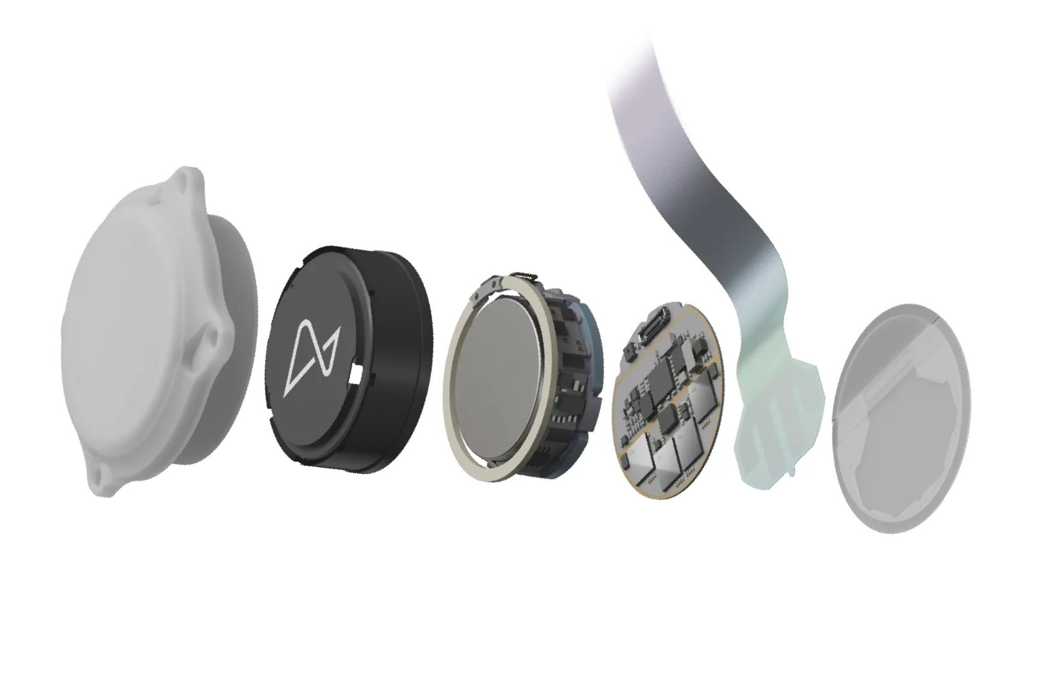
The GOOD
The Neuralink N1: a real-world example of a brain chip:
Entire operation is done in less than 60 minutes.
The invisibility and wireless charging of N1 from outside the body.
Two main motivations for brain chips:
Restoration and Enhancement.

Slide 7
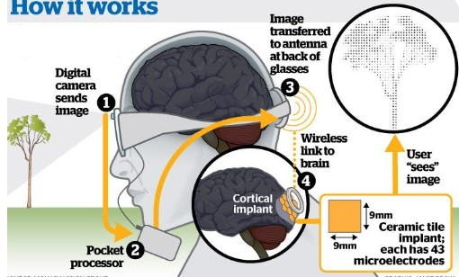
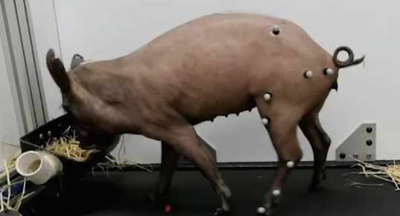
The GOOD: Restoration
Restoring vision to the blind and expanding human sensory capabilities.
Potential to cure paralysis, restoring mobility and independence. Example of a pig's spinal cord experiment for curing paralysis.

Slide 8
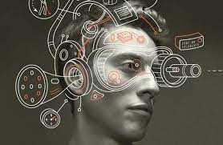
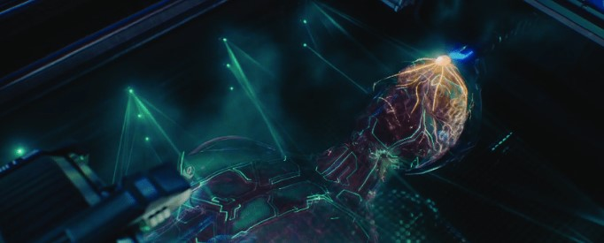
The GOOD: Enhancement.
Next-gen N2 chip.
Improving clarity, zooming ability, and more advanced functions.
Possibility of advanced communication and functions like internal picture storage, mood control.
The potential of digital resurrection after death.

Slide 9
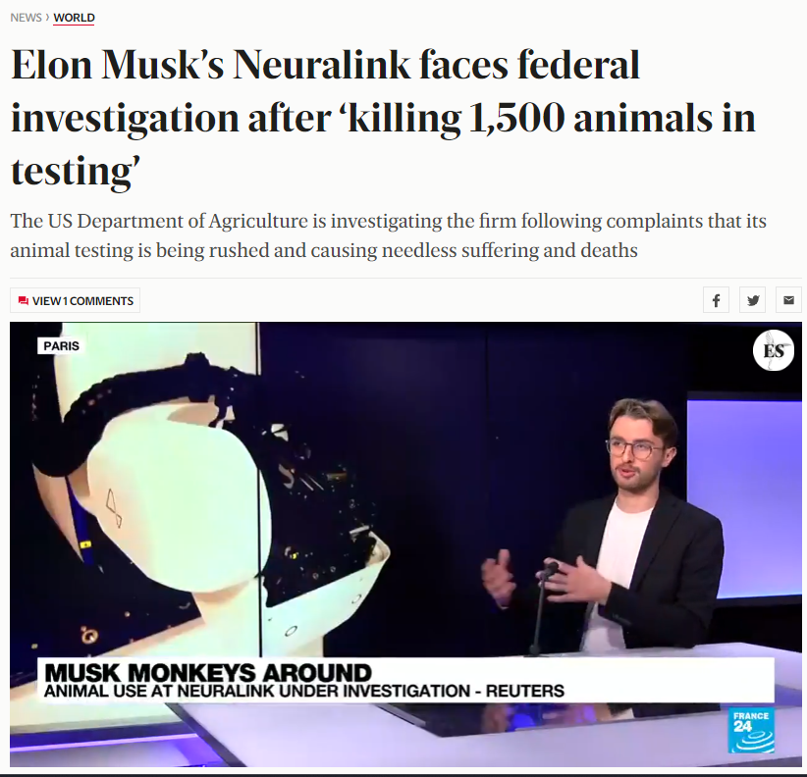


The BAD:
Ethical concerns due to extensive testing on animals.
Neuralink's potential violation in terms of hazardous pathogen transportation.
The importance of FDA approval for human trials and its implications.
Future of our entire species rests on this decision by the FDA?

Slide 10
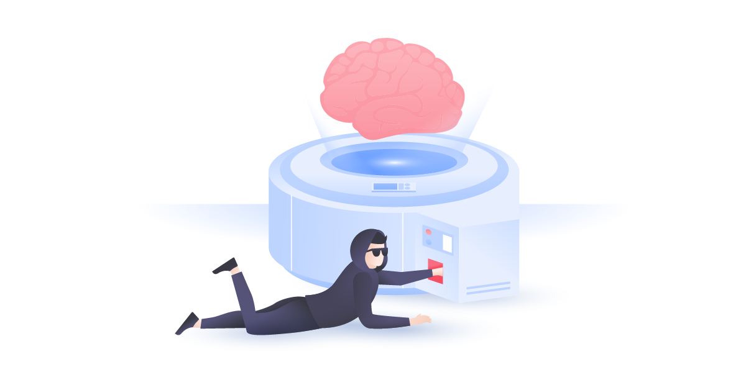
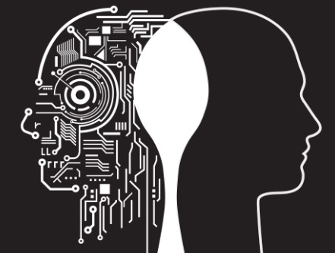

The UGLY
Risk of hacking.
Computer viruses infecting humans.
Dependency on brain chip.
Societal division.
The affordability issue: potential for socioeconomic inequality.
Potential negative business practices.

Slide 11
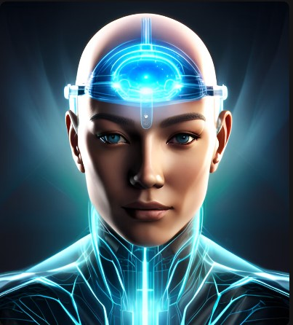
Conclusion

Slide 12
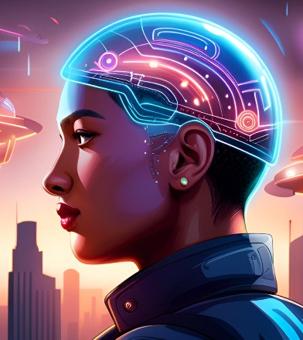
Any Questions?

Slide 13
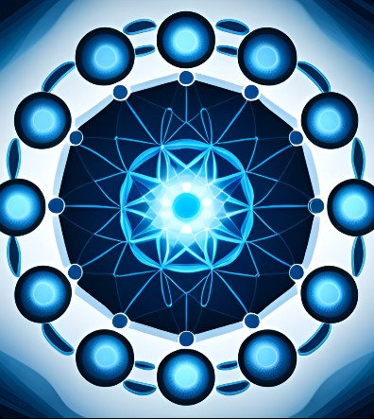
Thank You ☺

